Slide 1
Protecting satellites from space radiation

Slide 2
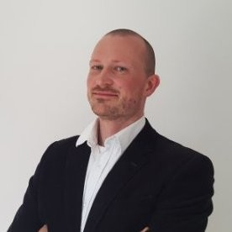
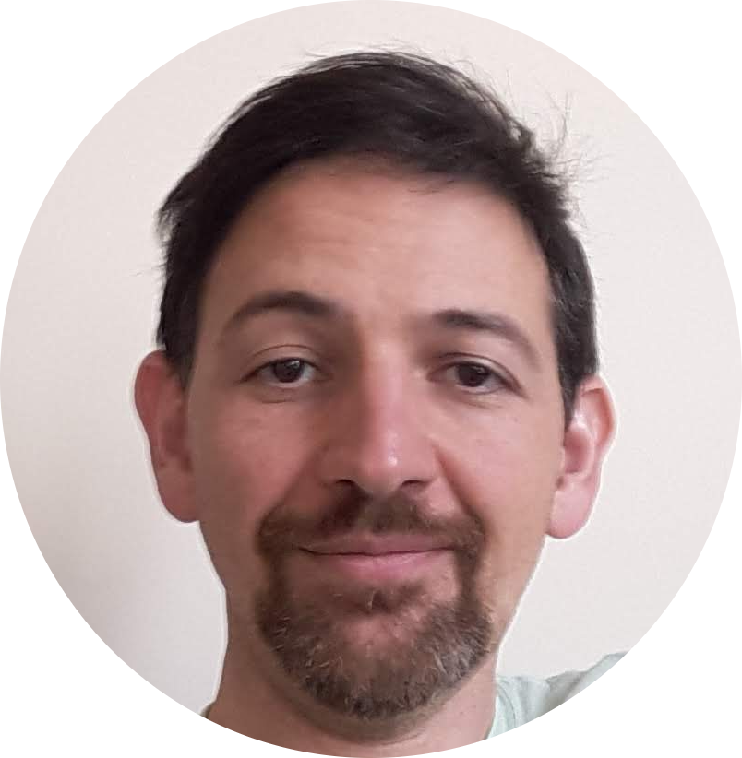
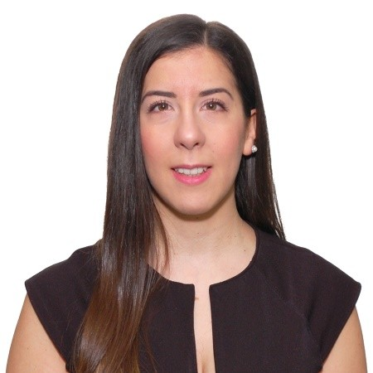
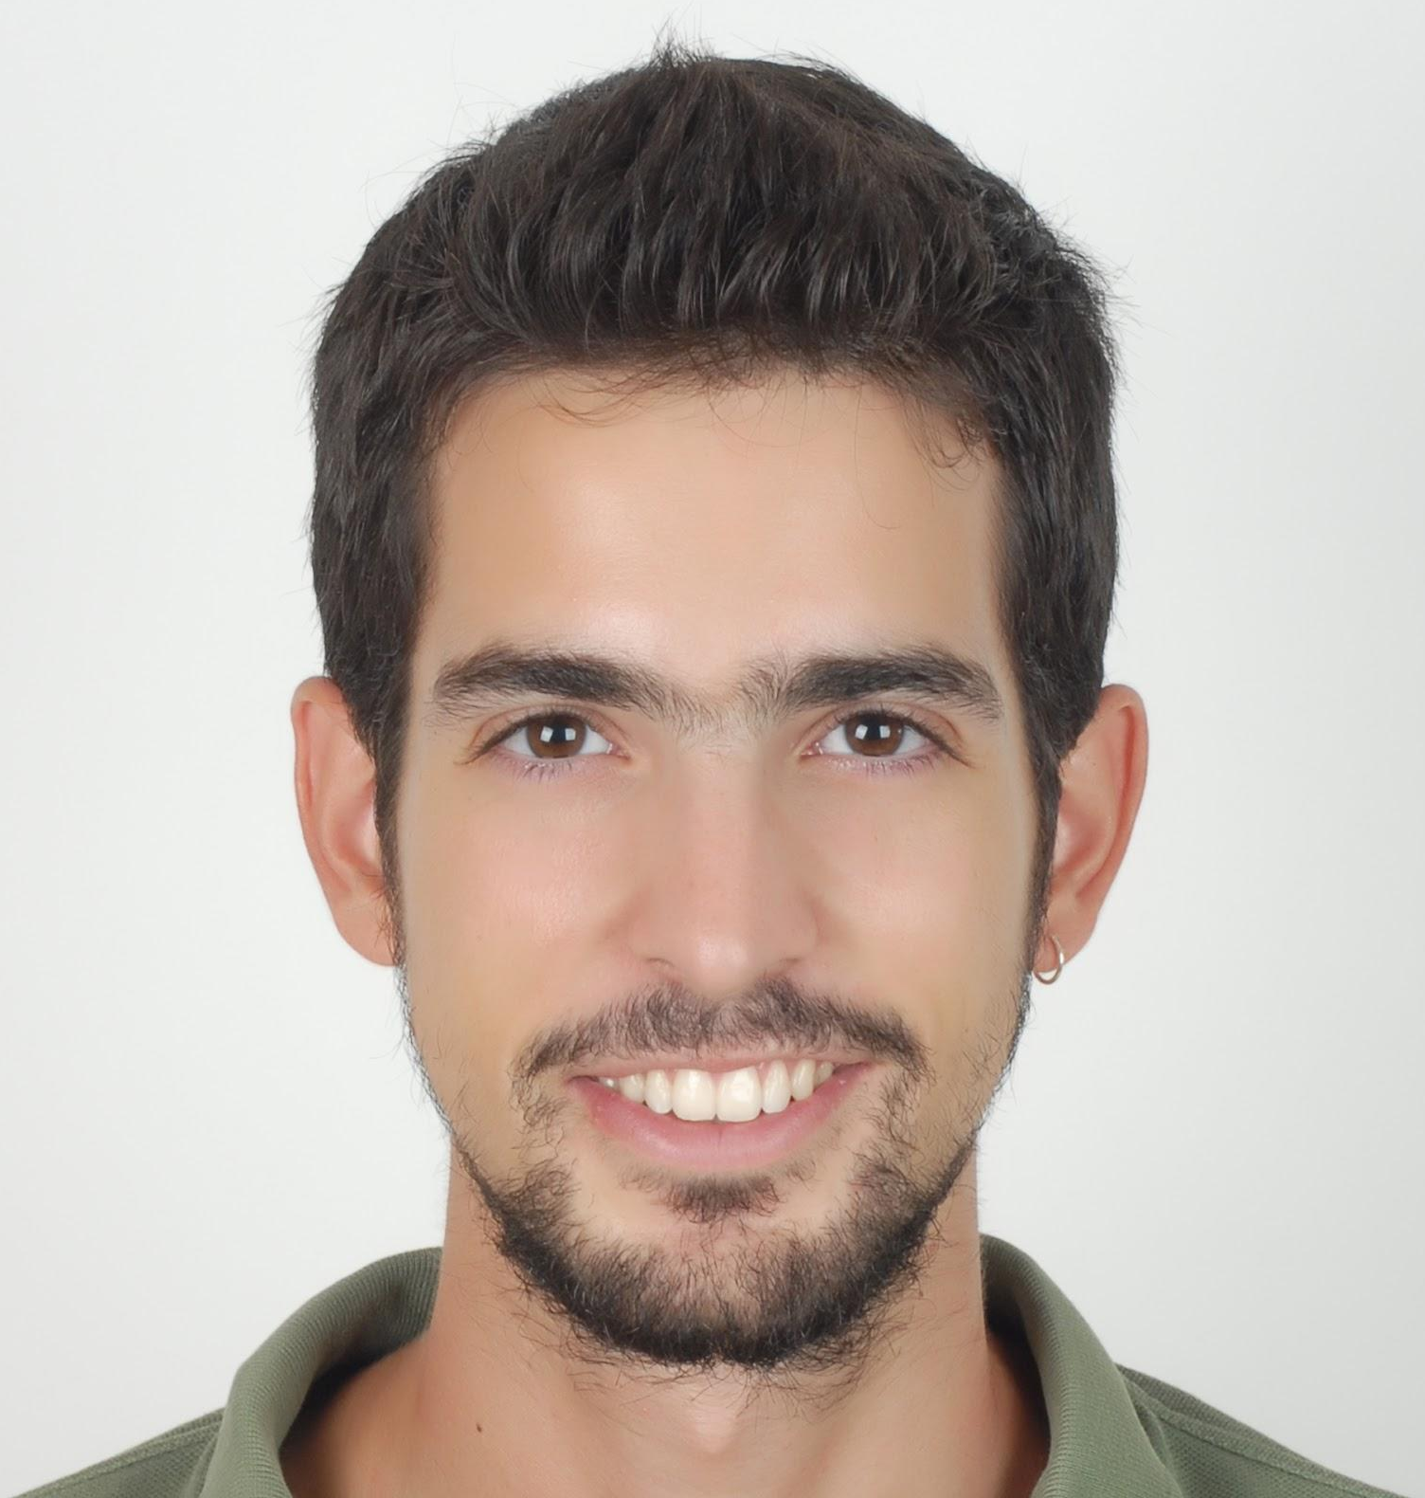
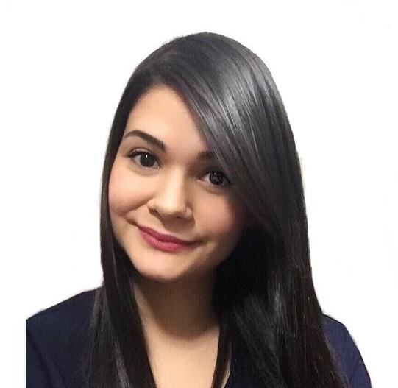
Team - Magnetics embedded in structure
Bruno Bolsens, PhD Investor
Product strategy
Majed Jawad, PhD Co-Founder and CTO
R&D and magnetic shielding
Violeta Argyropoulou, MBA Advisor
Growth strategy
Alexandros Christou, PhD Co-Founder and CEO
Commercialisation and mechanics
Maria Tejera Hernández, MSc Aerospace Engineer
Technology integration

Slide 3
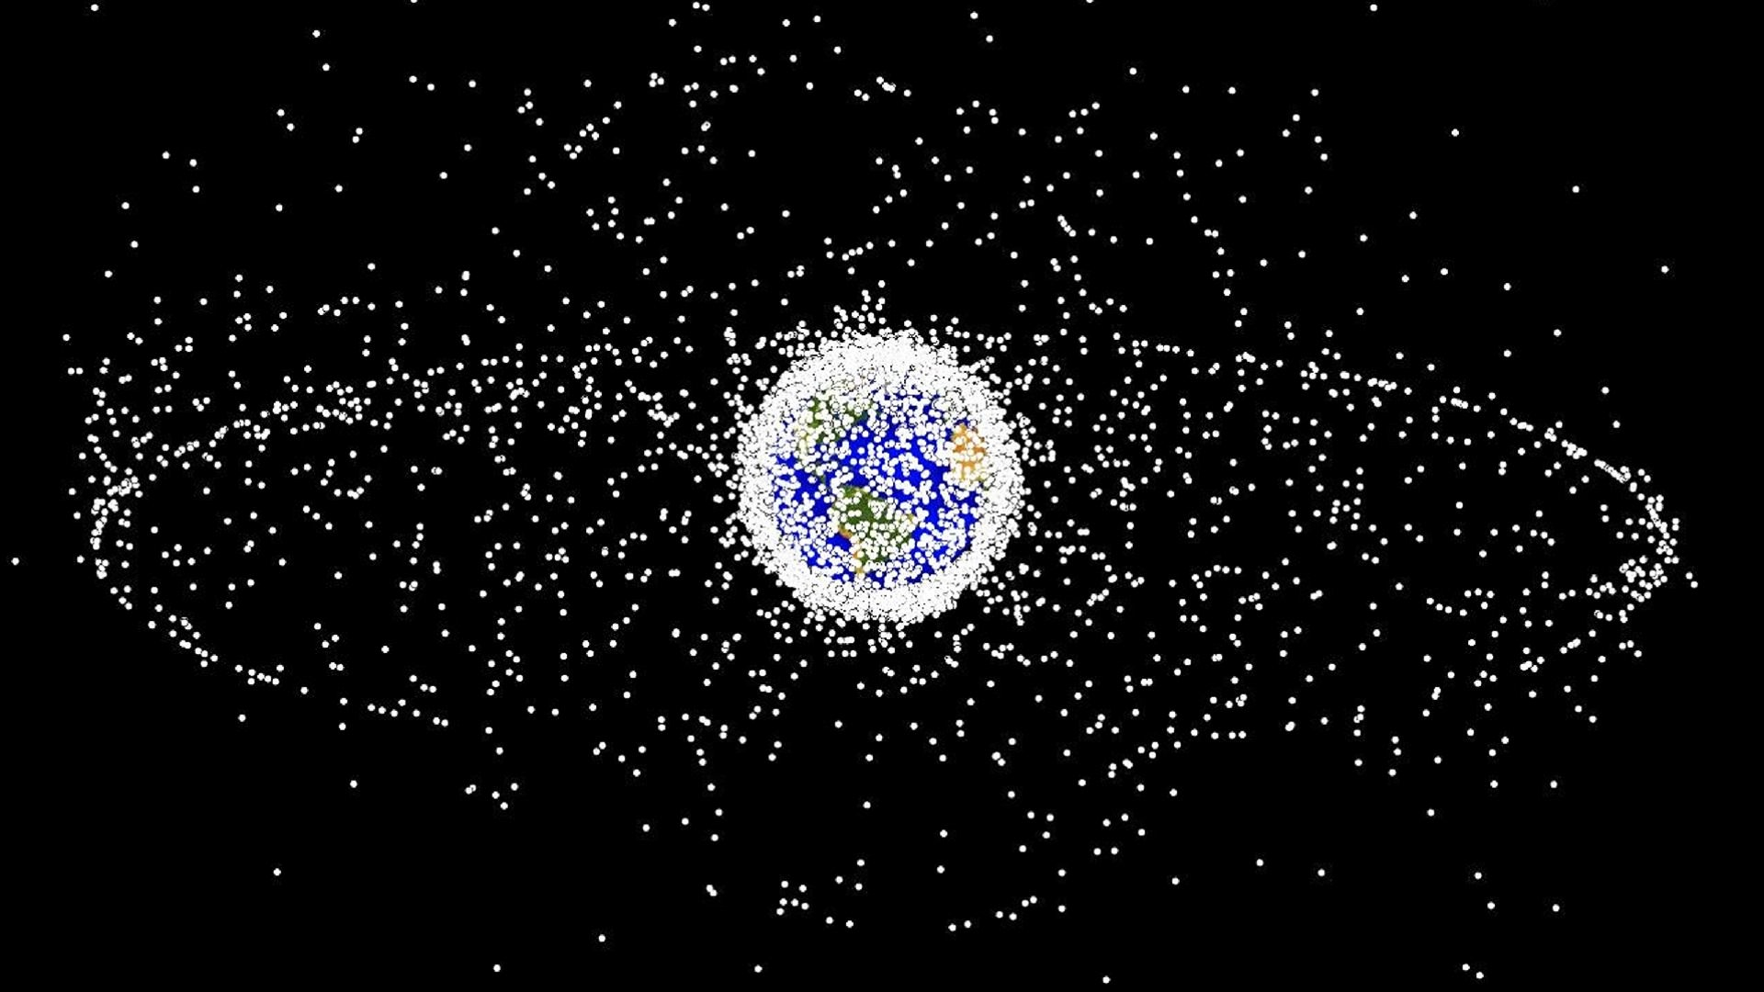
Space industry is changing
Space radiation has 10.000 more energy in higher orbits
Low Orbits
f
High Orbits
Radiation Hardened
2-5 years
2000 satellites Saturated
10-15 years
24 satellites
Unsaturated
Disruptors
(Tech startups)
Established players

Slide 4
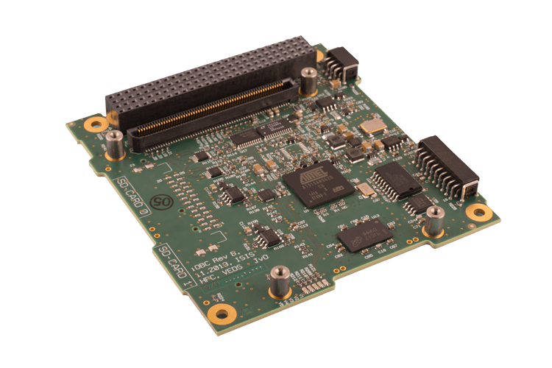
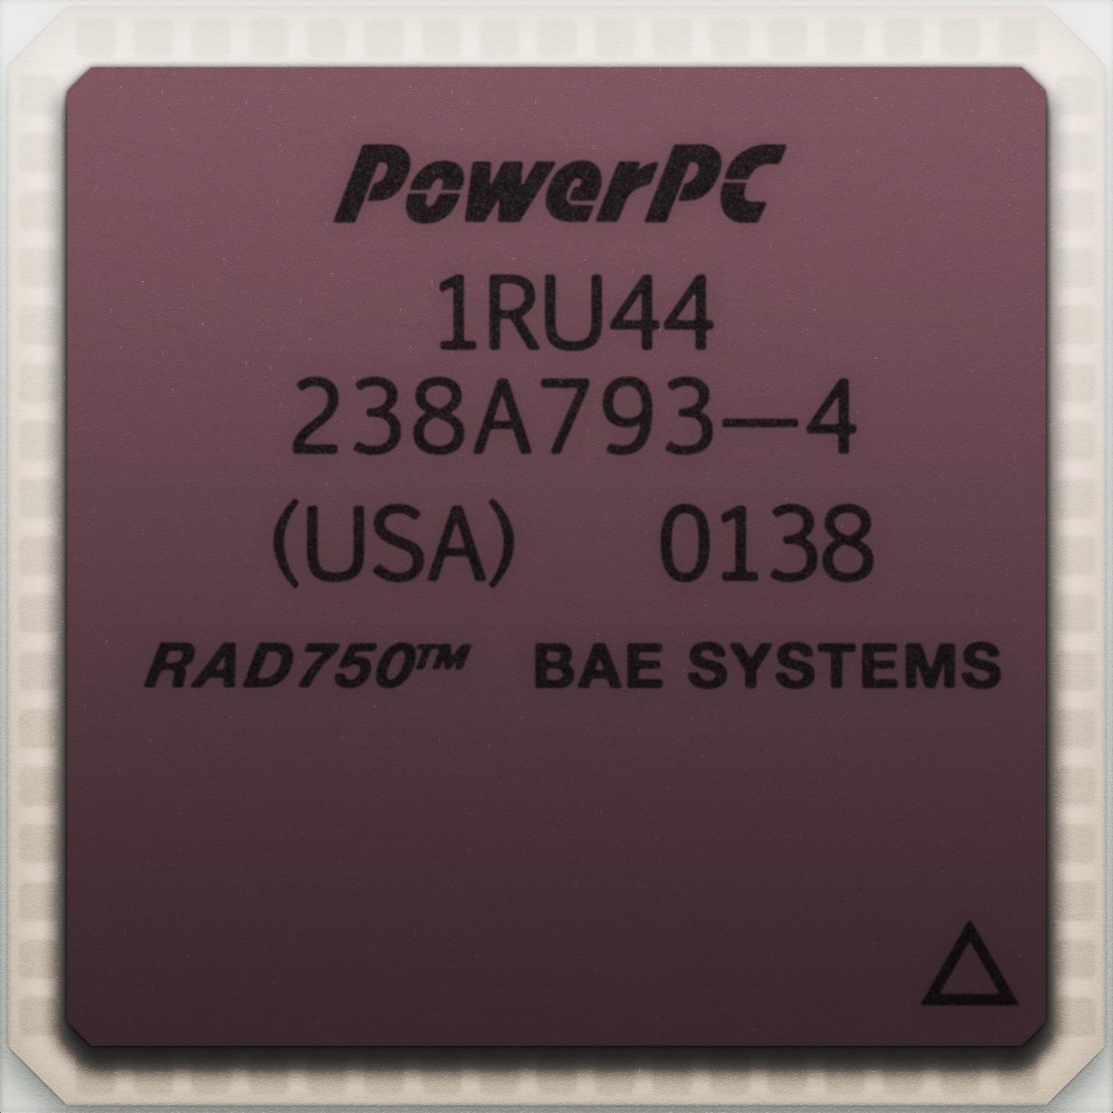
The unseen culprit: space radiation (MEO/GEO)
5 years 41% of lifetime
>$100M /satellite
$ 935M /year
Terrestrial Applications
Commercial-Off-The-Shelf
Space Applications
Radiation Hardened
Up to date
~$4k
10-20 year old
>$1M

Slide 5
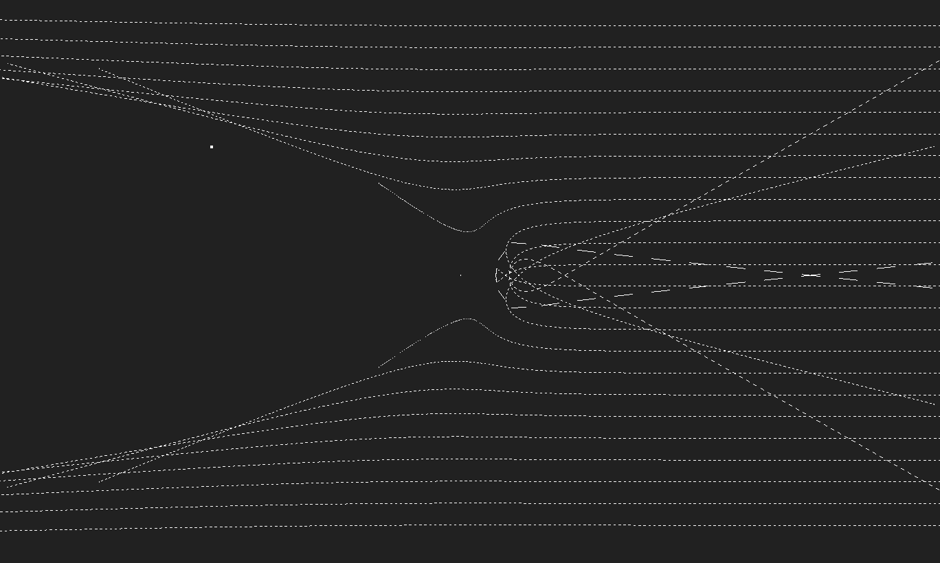
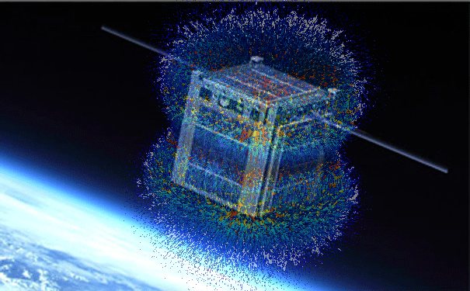
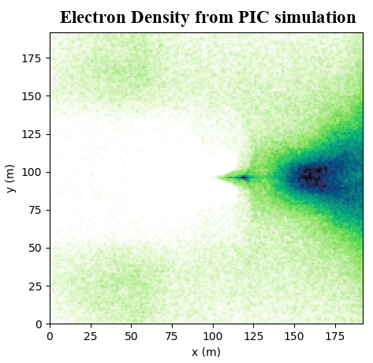
A different approach
Concept
Simulations
Experiments
Notes:
For Stormer: electrons only at 600km/s (solar wind speeds) (1A.m^2 dipole moment equivalent to 8.5 g of Neodymium magnets). PIC 6000 km/s proton+electrons at solar density (2.4 A.m^2 total dipoles => 20.4 g of Neodymium magnets). Experiment with neutral plasma and magnets ? 10 gauss - 1cm away

Slide 6
Competitor landscape
Our protective technology:
Generates COTS friendly zones.
Digital components - Improved satellite performance.
No switching cost.
System Performance
Implementation Cost

Slide 7
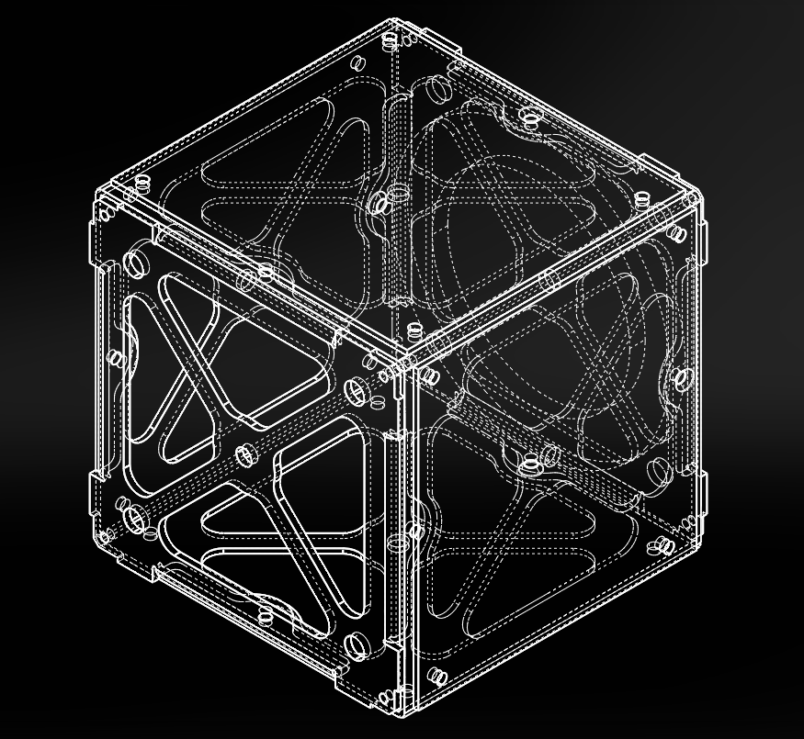
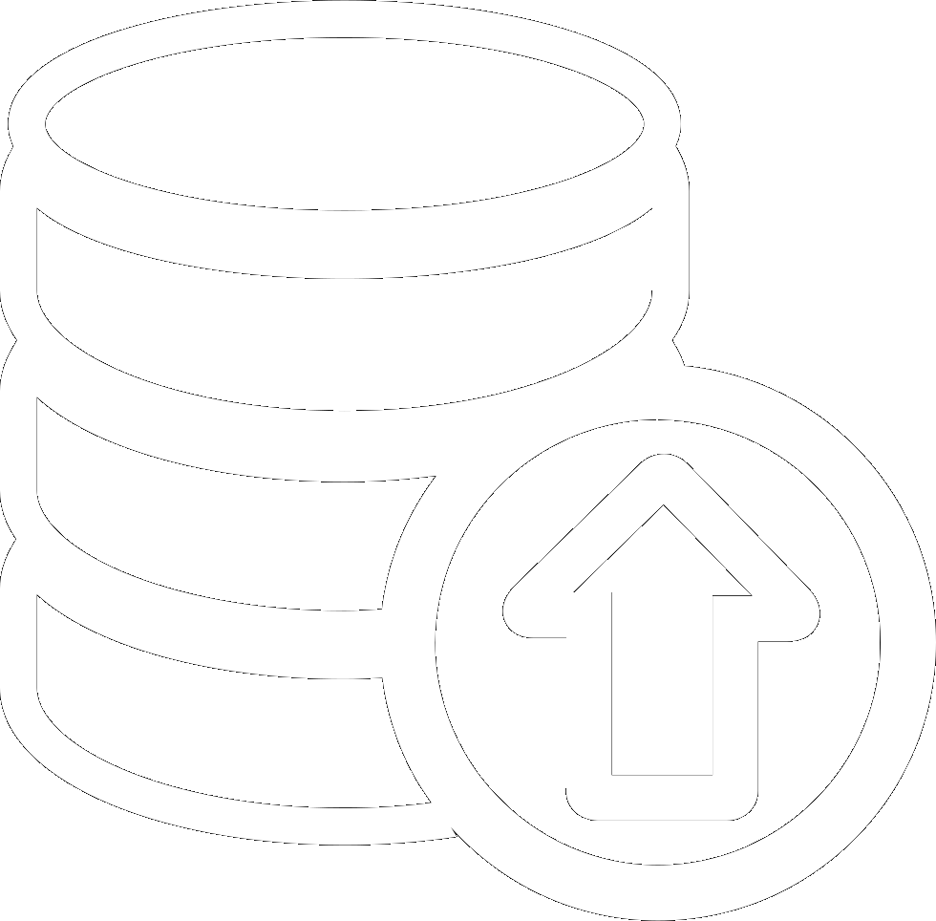
Products in development
$90M / satellite + enabling new digital systems on board.
Installation $5M + licence $1.2M / year of operation.
Notes:
Launch- conservative k realistic. Market size – Day 1.

Slide 8
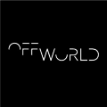
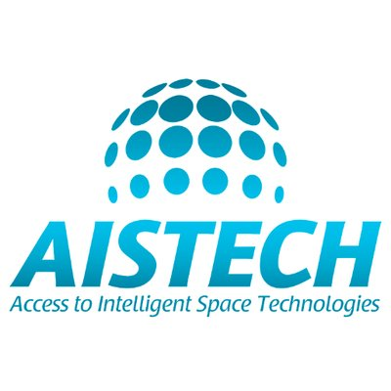
Market fit
“This is a game-changer with potential and value all across the board.”
Christos Kyriazoglou
CBDO
“This is extraordinary and super valuable.
My team has spent a year looking for alternatives to rad-hard.”
Jim Keravala
CEO
“If anybody says that they do not have a problem with space radiation, they are either lying, or they do not know what they are doing.”
Josep Pino
CTO

Slide 9
Achievements
Funded proposal <£50k
Stage 1 contract <£100k
Funded proposal <£100k
Top 10 startup finalist
Funded proposal <£3k

Slide 10
Roadmap
+50%
+100%
+150%
Prototype tested
Integration
Qualification
May 2018
July
Feb 2019
Mar 2020
Dec 2020
Angels + Grants
Early Seed
Further funding required £3M

Slide 11
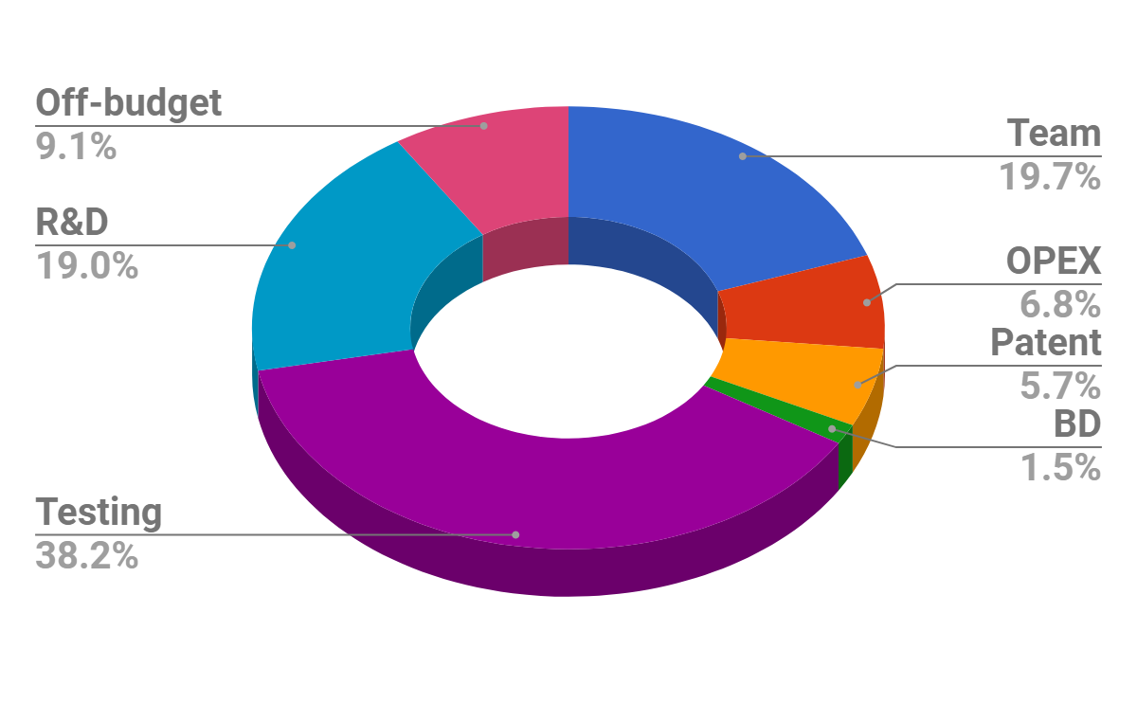
Allocation of funds

Slide 12
Vision - Beyond shielding
New applications
Radiation as an energy source
Be the first to manipulate plasma in space

Slide 13
Find out more. www.spacetalos.com

